Slide 2
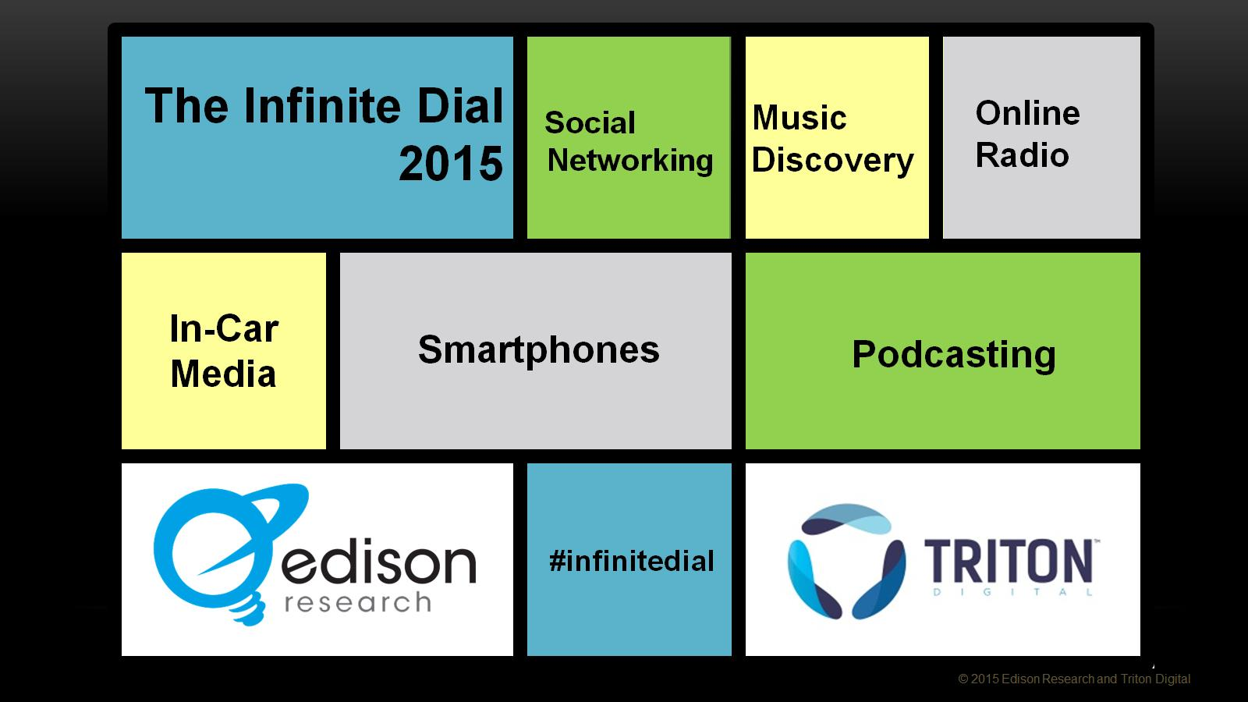

Slide 3
Study Overview

Slide 4
Technology changes in society

Slide 5
Medium most essential

Slide 6
Medium used first in event of a major news story

Slide 7
Medium used first to learn about new music

Slide 9
Monthly Online Radio Listening

Slide 10
Monthly Online Radio Listening (Age)

Slide 11
Weekly Online Radio Listening

Slide 12
Weekly Online Radio Listening (Age)

Slide 13
Average time ‘Weekly Online Radio Listeners’ spend listening to Online Radio

Slide 14
Devices used to listen to Online Radio

Slide 15
Online Radio Listening in Car

Slide 16
Online Radio Listening in Car

Slide 18
When thinking about Internet-only audio, what is the FIRST word that comes to mind?

Slide 19
Audio Brand Awareness

Slide 20
Audio Brand Usage

Slide 21
Listened in the last month to…

Slide 22
Listened in the last month to…

Slide 23
Listened in the last month to… (Age)

Slide 24
Listened in the last week to…

Slide 25
Listened in the last week to…

Slide 26
Listened in the last week to… (Age)

Slide 27
Audio Brand used most often

Slide 28
Audio Brand used most often (Age 12-24)

Slide 29
YouTube Usage

Slide 30
YouTube Usage

Slide 32
Importance of keeping up-to-date with music

Slide 33
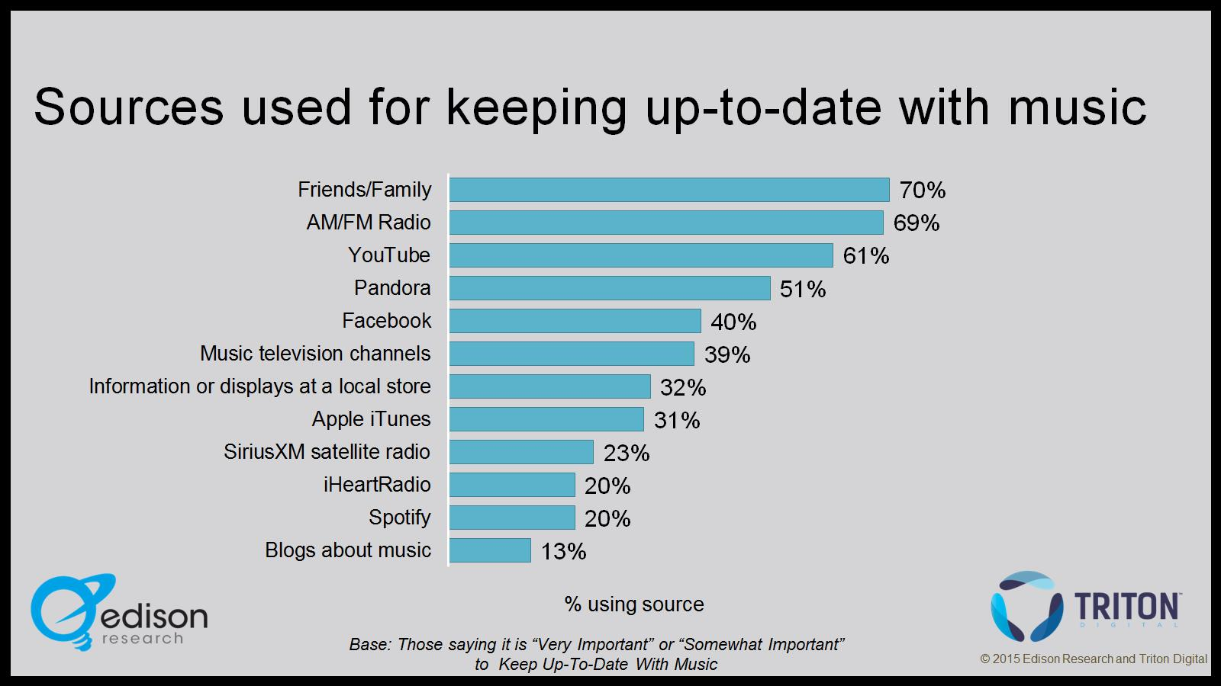
Sources used for keeping up-to-date with music

Slide 34
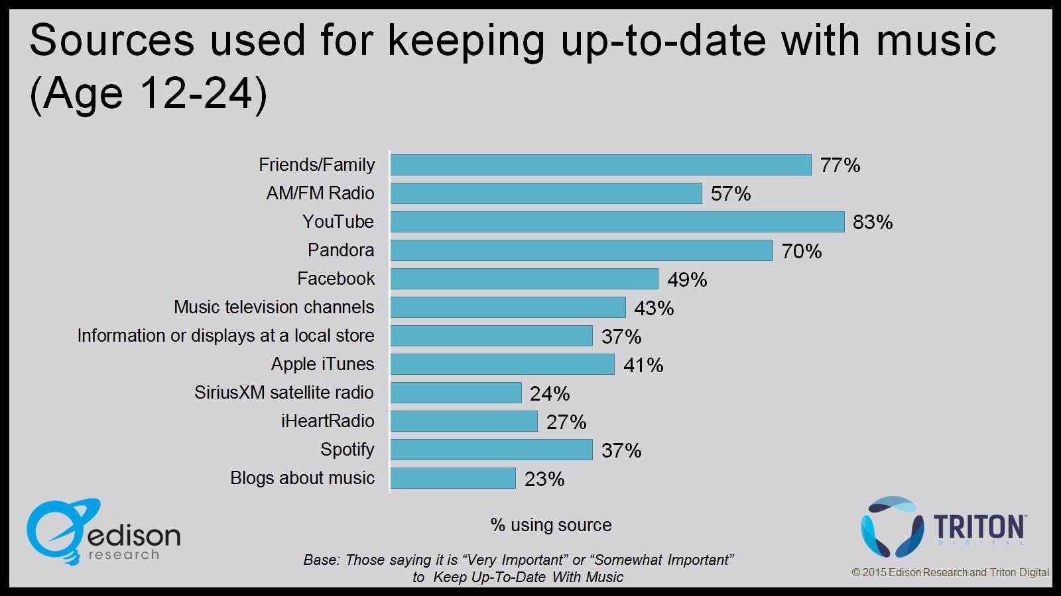
Sources used for keeping up-to-date with music (Age 12-24)

Slide 35
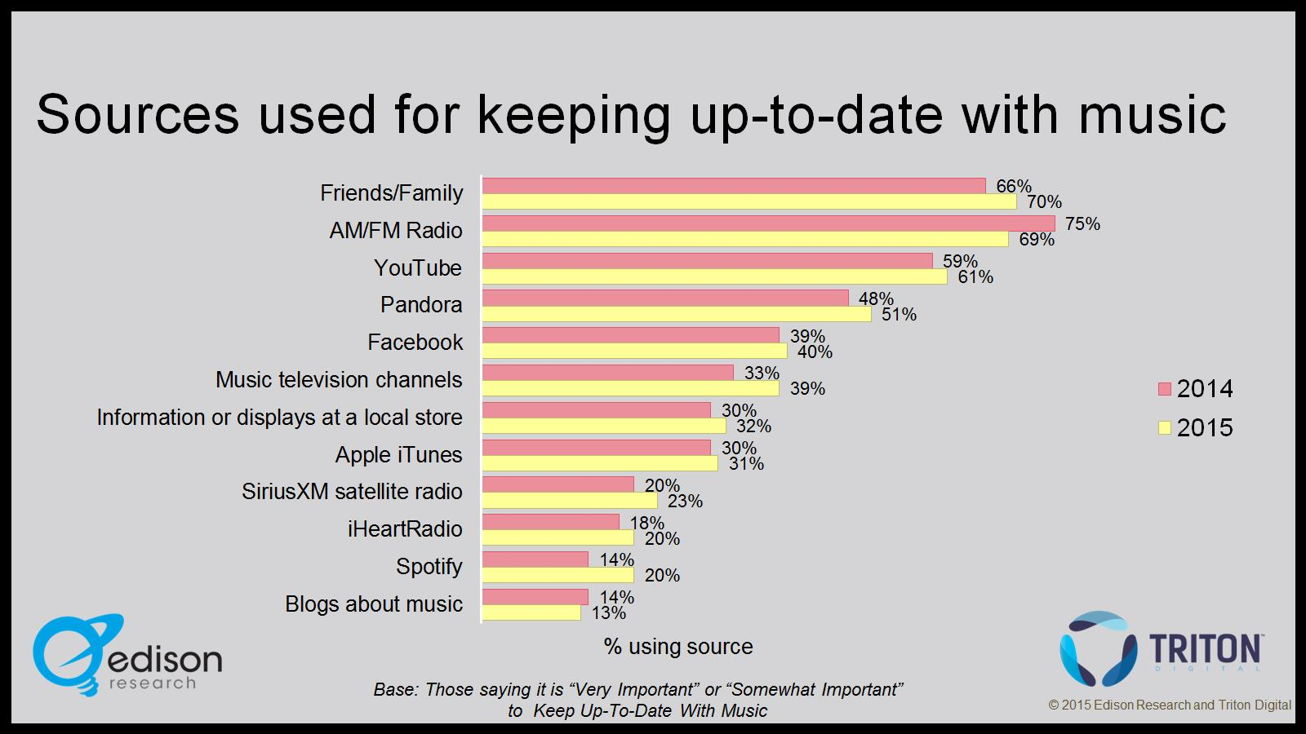
Sources used for keeping up-to-date with music

Slide 36
Source used most for keeping up-to-date with music

Slide 37
Source used most for keeping up-to-date with music (Age 12-24)

Slide 38
Source used most for keeping up-to-date with music

Slide 39
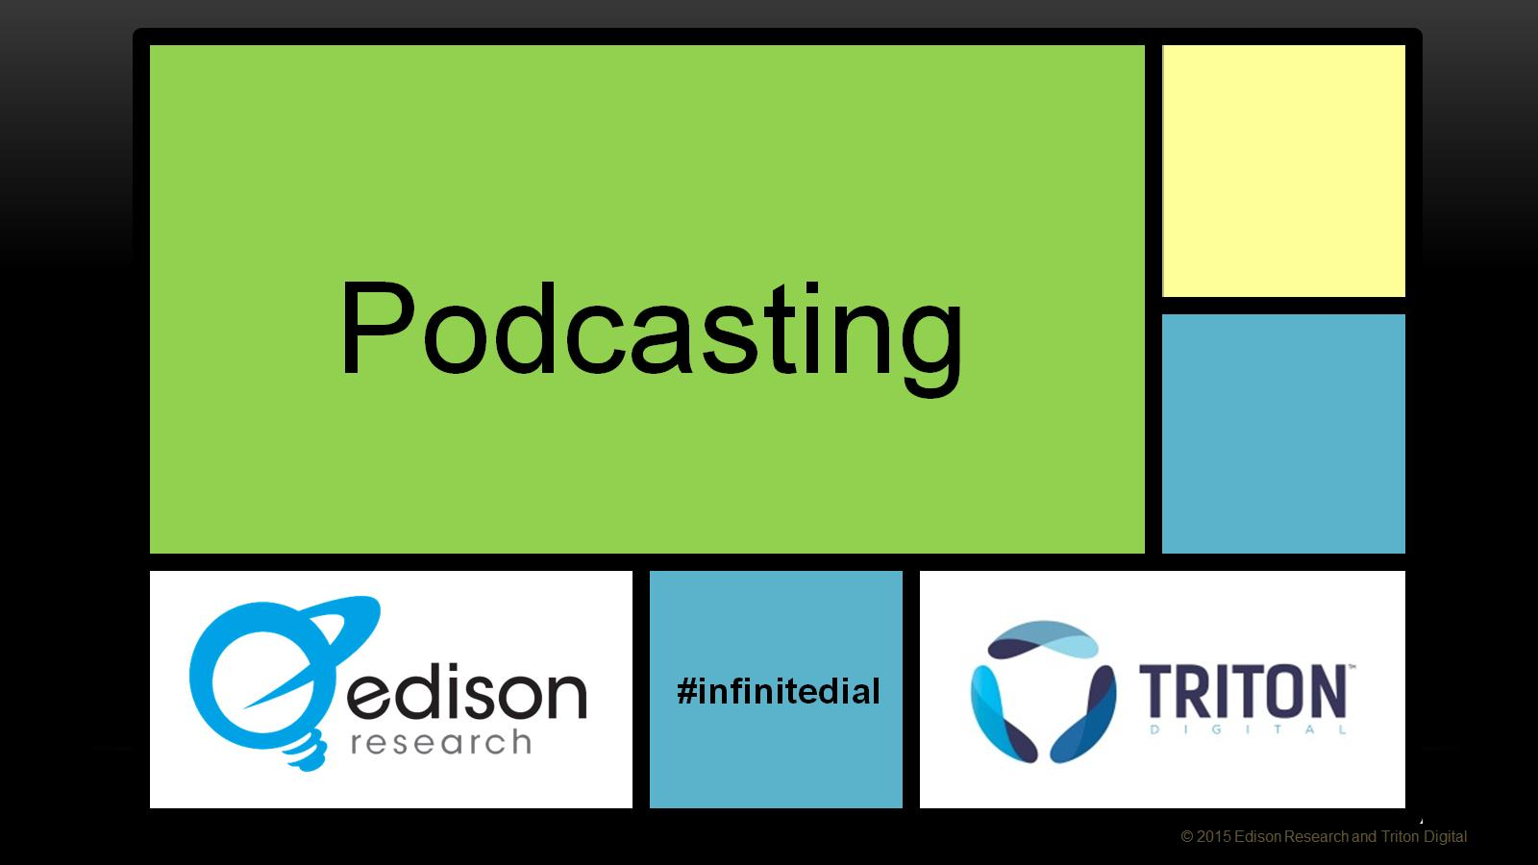

Slide 40
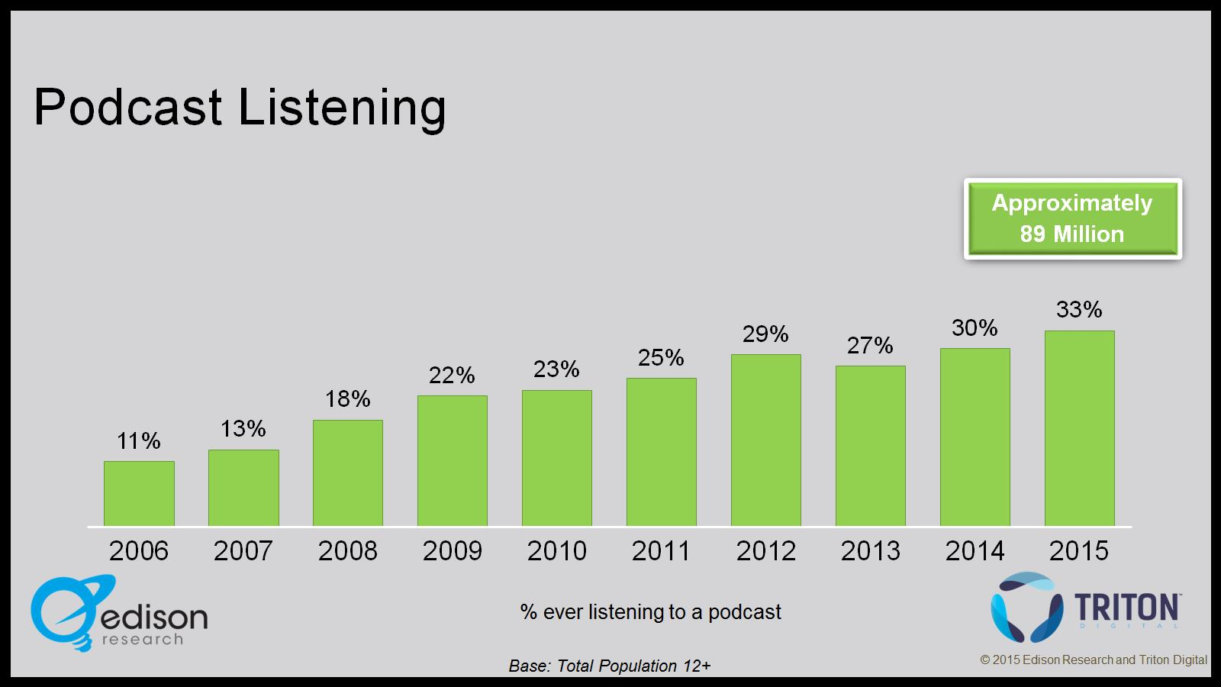
Podcast Listening

Slide 41
Devices used most often to listen to podcasts

Slide 42
Monthly Podcast Listening

Slide 43
Weekly Podcast Listening

Slide 44
Podcast Listening: (Education)

Slide 45
Podcast Listening: (Income)

Slide 46
Number of Podcasts listened to in last week

Slide 47
“Serial” Podcast

Slide 49
Smartphone Ownership

Slide 50
Smartphone Ownership (Age)

Slide 51
Smartphone Apps

Slide 52
Smartphone Data Plan Consideration

Slide 53
Smartphone Data Plan Consideration

Slide 54
Shazam and SoundHound

Slide 55
Tablet Ownership

Slide 56
Internet-connected TV Ownership

Slide 58
Audio sources used in primary car

Slide 59
Audio sources used in primary car

Slide 60
Audio sources used at least ‘most of the times’ in primary car

Slide 61
Audio sources used at least ‘most of the times’ in primary car

Slide 62
In-Dash Information and Entertainment Systems

Slide 63
In-Dash Information and Entertainment Systems

Slide 65
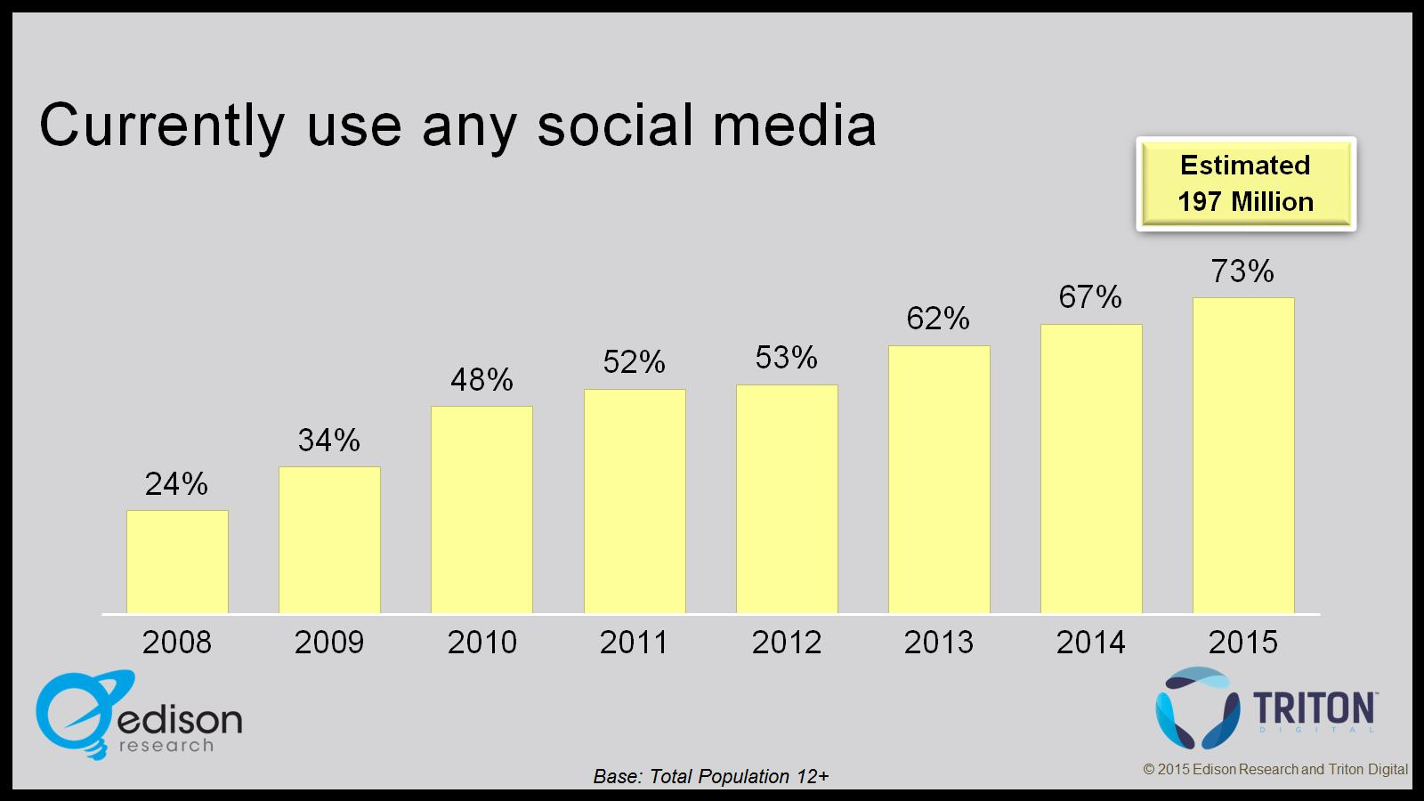
Currently use any social media

Slide 66
Social Media Awareness

Slide 67
Social Media Usage

Slide 68
Social Media Usage

Slide 69
Social Media Usage (Age 12-24)

Slide 70
Usage of Social Media “Several Times per Day”

Slide 71
Social Media site used most often

Slide 72
Social Media site used most often (Age 12-24)

Slide 74
Observations

Slide 75
Observations

Slide 76
Observations

Slide 77
Observations

